Slide 1
Session 3
Operators
and
Expressions

Slide 2
Session objectives (1)
Identify operators
Assignment
Arithmetic
Compound
Assignment
Relational
Logical
Bitwise
Understand precedence and evaluation
of operators

Slide 3
Session objectives (2)
Discuss mixed mode expressions
and implicit type conversions
Understand type casting
and type compatibility
Identify C++ shorthand operators

Slide 4
Introduction
Operators are:
Are a set of characters
Have specific meaning particular to a language
Do not include special characters
; “ : ,

Slide 5
Operands
Variables
Constants
Both
or

Slide 6
Binary Arithmetic Operators (1)
Require two operands
+
-
*
/
%

Slide 7

Binary Arithmetic Operators (2)
Adds the values of operands
+
b
a
result =
The addition operator

Slide 8
Binary Arithmetic Operators (3)
Subtracts the second operand from first
b
a
answer =
-
The subtraction operator

Slide 9
Binary Arithmetic Operators (4)
Multiplies the operands
*
b
a
ans =
The multiplication operator

Slide 10
Binary Arithmetic Operators (5)
Divides the first operand by the second
/
b
a
result =
The division operator

Slide 11
Binary Arithmetic Operators (6)
Store the remainder after integer division
%
b
a
answer =
The modulus operator

Slide 12
Binary Arithmetic Operators (7)
void main(void)
{ :
cout << endl ;
f_dist = f_speed * f_time ;
cout<<"The distance covered by the vehicle = " ; cout<< f_dist ;
cout << endl ;
}
Multiplication operator

Slide 13
Unary arithmetic operators (1)
Require one operand
Negation operator -
int x; int x= -3
Decrement operator - -
puls - - OR - - puls
Increment operator ++
stnd ++ OR ++stnd

Slide 14
#include <iostream.h> void main(void)
{ int value ; value = 1 ; cout << "THE INCREMENT OPERATOR" << endl ; cout << "Value of value: " << value << endl ; cout << "Pre-fix increment operator (++value): " << ++value ; cout << endl ; cout << "Value of value: " << value << endl ; cout << "Post-fix increment operator (value++): " << value++ ; cout << endl ; cout << "Value of value: " << value << endl ;
Unary arithmetic operators (2)

Slide 15
Unary arithmetic operators (3)
cout << "\n\nTHE DECREMENT OPERATOR" << endl ;
cout << "Value of value: " << value << endl ;
cout << "Pre-fix decrement operator (--value): " << --value ;
cout << endl ;
cout << "Value of value: " << value << endl ;
cout << "Post-fix decrement operator (value--): " << value-- ;
cout << endl ;
cout << "Value of value: " << value << endl ;
}

Slide 16
Assignment operator
General format
variable_name = expression ;
Assignment operator

Slide 17
Multiple assignment
int var_1, var_2, var_3 ;
var_1 = 70 ;
var_2 = 70 ;
var_3 = 70 ;
var_1 = var_2 = var_3 = 70 ;
int var_1 = int var_2 = int var_3 ;

Slide 18
Relational operators (1)
Used for
- Comparative action on data
- test relationship between variables

Slide 19
Relational operators (2)
== Equal to
> Greater than
< Less than
!= Not equal to
>= Greater than or equal to
<= Less than or equal to

Slide 20
Relational operators (3)
Equal to
Less than
Greater than
Equal to
b < 3
b == 3
b== c
b < c
b >= 3
b>= c
Greater than
Less than
Equal to
Not equal to
b > 3
b!= 3
b!= c
b <= 3
b > c
b <= c

Slide 21

Logical operators (1)
Symbols used to
combine or negate
expressions containing
relational operators

Slide 22
Logical operators (2)
AND
qual == 12 && age == 18
OR
qual == 10 || age == 18
NOT
( ! ( age >= 18) )

Slide 23
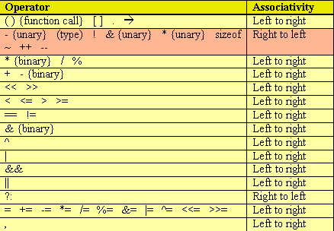
Precedence and Order of Evaluation

Slide 24
Mixed mode Expressions & Implicit Type conversion
X = 5 * 6.7 ;
Implicit conversion
integer
float
No error
Integer converted to double automatically

Slide 25
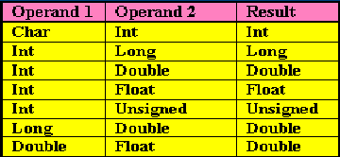
Conversion table

Slide 26
Type conversion (1)
Integer value converted
to its floating- point equivalent
Integer
values
Floating
point
variables
Value is not changed

Slide 27
Type conversion (2)
Floating-point value converted
to integer type
Integer
values
Floating
point
variables
Value is changed

Slide 28
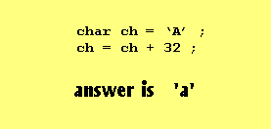
Adding integers to characters
Character type data
ASCII value
0 to 255

Slide 29
Type casting (1)
Implicit Type Conversions
Often leads to
Errors
Use explicit type conversions
in mixed mode expressions
float a ;
(int) a ;

Slide 30
Type casting (2)
float a=10.0, b= 3.0, c;
c= a / b;
Ans= 3.333333
c = (int) a / (int) b OR c = (int) (a / b)
Ans= 3

Slide 31
C++ Shorthand Operators (1)
Help in reducing the code
required in programming constructs
test_val = test_val + 5;
test_val += 5;

Slide 32
C++ Shorthand Operators (2)
Every shorthand operator
consists of
An arithmetic operator
+, -, /, *, %

Slide 33
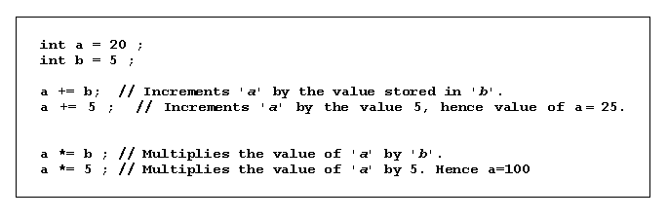
C++ Shorthand Operators (3)

